Slide 1
Mathematical Foundations for ML (10-606):
Probability
Bryan Wilder
* Slides borrowed from prior offerings by Professors M. Gormley, P. Virtue, & G. Gordon, & H. Heidari.

Slide 2
Problem
Suppose that you roll a dice that comes up either 1, 2, 3, or 4. However, the dice is weighted and may not have uniform probabilities. Let:
A be the event that you roll either a 1 or a 3
B be the event that you roll a 2, 3, or 4
C be the event that you roll a 1
D be the event that you roll a 2 or a 4
Suppose that P(A) = 0.4, P(B) = 0.7, and P(C) = 0.3. What is P(D)?

Slide 3
Problem
Suppose that you roll a dice that comes up either 1, 2, 3, or 4. However, the dice is weighted and may not have uniform probabilities. Let:
A be the event that you roll either a 1 or a 3
B be the event that you roll a 2, 3, or 4
C be the event that you roll a 1
D be the event that you roll a 2 or a 4
Suppose that P(A) = 0.4, P(B) = 0.7, and P(C) = 0.1. What is P(D)?
P({3}) = P(A) – P(C) = 0.1
P(D) = P({2, 4}) = P(B) – P({3}) = 0.6

Slide 4
Reminders
Quiz 3 during Friday recitation
HW 7 due Sunday

Slide 5
You look at pizzas coming out of the oven at your local pizza place. 50% have spinach and 30% have peperoni. 30% have neither spinach or peperoni. What is the probability that a pizza has both?
Notes:
Pr(s = 1) = 0.5
Pr(p = 1) = 0.3
Pr(p = 0, s = 0) = 0.3
Pr(p = 0, s= 1) + Pr(p = 0, s = 0) = Pr(p = 0) = 1 – Pr(p = 1) = 0.7
Pr(p = 0, s= 1) = 0.4
Pr(p = 0, s = 0) + Pr(p = 1, s = 0) = Pr(s = 0) = 1 – Pr(s = 1) = 0.5
Pr(p = 1, s = 0) = 0.2
Pr(p = 1, s = 1) = 1 – (Pr(p = 0, s = 0) + Pr(p = 1, s = 0) + Pr(p = 0, s = 1)) = 0.1

Slide 6
You look at pizzas coming out of the oven at your local pizza place. 50% have spinach and 30% have peperoni. 30% have neither spinach or peperoni. What is the probability that a pizza has both?
Pr(s = 1) = 0.5
Pr(p = 1) = 0.3
Pr(p = 0, s = 0) = 0.3

Slide 7
You look at pizzas coming out of the oven at your local pizza place. 50% have spinach and 30% have peperoni. 30% have neither spinach or peperoni. What is the probability that a pizza has both?
Pr(s = 1) = 0.5
Pr(p = 1) = 0.3
Pr(p = 0, s = 0) = 0.3
Pr(p = 0, s= 1) + Pr(p = 0, s = 0) = Pr(p = 0) = 1 – Pr(p = 1) = 0.7
Pr(p = 0, s= 1) = 0.4

Slide 8
You look at pizzas coming out of the oven at your local pizza place. 50% have spinach and 30% have peperoni. 30% have neither spinach or peperoni. What is the probability that a pizza has both?
Pr(s = 1) = 0.5
Pr(p = 1) = 0.3
Pr(p = 0, s = 0) = 0.3
Pr(p = 0, s= 1) + Pr(p = 0, s = 0) = Pr(p = 0) = 1 – Pr(p = 1) = 0.7
Pr(p = 0, s= 1) = 0.4
Pr(p = 0, s = 0) + Pr(p = 1, s = 0) = Pr(s = 0) = 1 – Pr(s = 1) = 0.5
Pr(p = 1, s = 0) = 0.2

Slide 9
You look at pizzas coming out of the oven at your local pizza place. 50% have spinach and 30% have peperoni. 30% have neither spinach or peperoni. What is the probability that a pizza has both?
Pr(s = 1) = 0.5
Pr(p = 1) = 0.3
Pr(p = 0, s = 0) = 0.3
Pr(p = 0, s= 1) + Pr(p = 0, s = 0) = Pr(p = 0) = 1 – Pr(p = 1) = 0.7
Pr(p = 0, s= 1) = 0.4
Pr(p = 0, s = 0) + Pr(p = 1, s = 0) = Pr(s = 0) = 1 – Pr(s = 1) = 0.5
Pr(p = 1, s = 0) = 0.2
Pr(p = 1, s = 1) = 1 – (Pr(p = 0, s = 0) + Pr(p = 1, s = 0) + Pr(p = 0, s = 1)) = 0.1

Slide 10
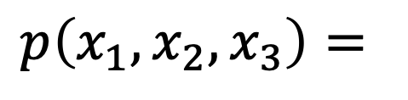
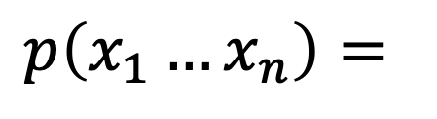
The Chain Rule
More generally, can always write any joint distribution as an incremental product of conditional distributions
$$p\left(x_{1}, x_{2},x_{3}\right)=$$
$$p\left(x_{1}…x_{n}\right)=$$
Notes:
Show multiple different factorizations

Slide 11
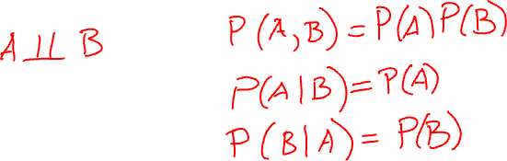
Independence
Variables where knowing one does not reveal any information about the other
Notes:
A \perp B
P(A, B) = P(A, B)
P(A|B) = P(A)
P(B|A) = P(B)

Slide 12

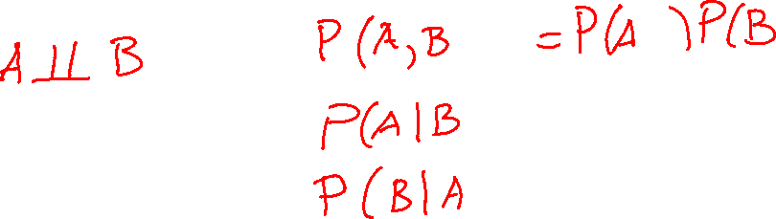
Conditional Independence

Slide 13
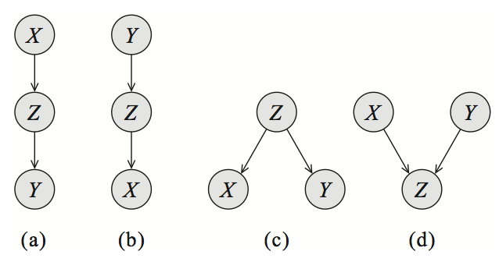
Probabilistic graphical models
Model data by describing what conditional independent relationships we believe hold vs which variables are dependent

Slide 14
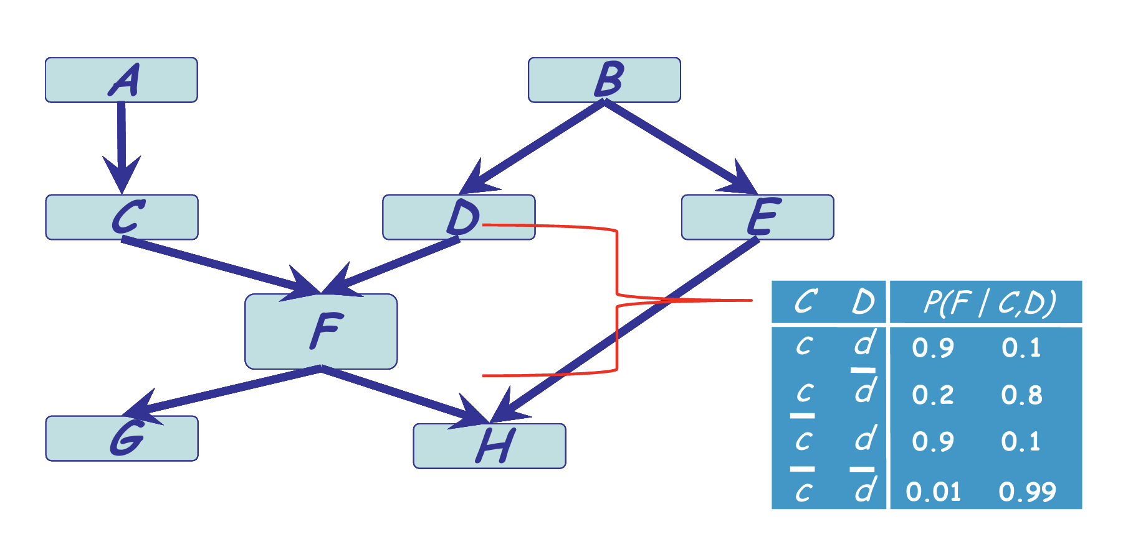
Bayesian network

Slide 15
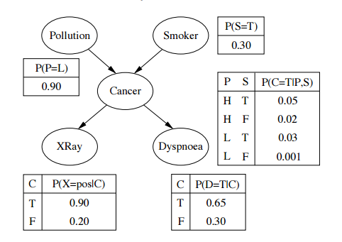

Slide 16
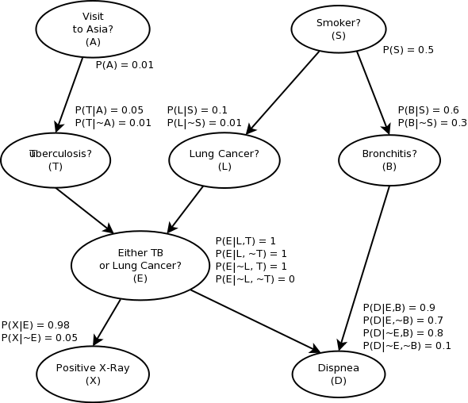

Slide 17
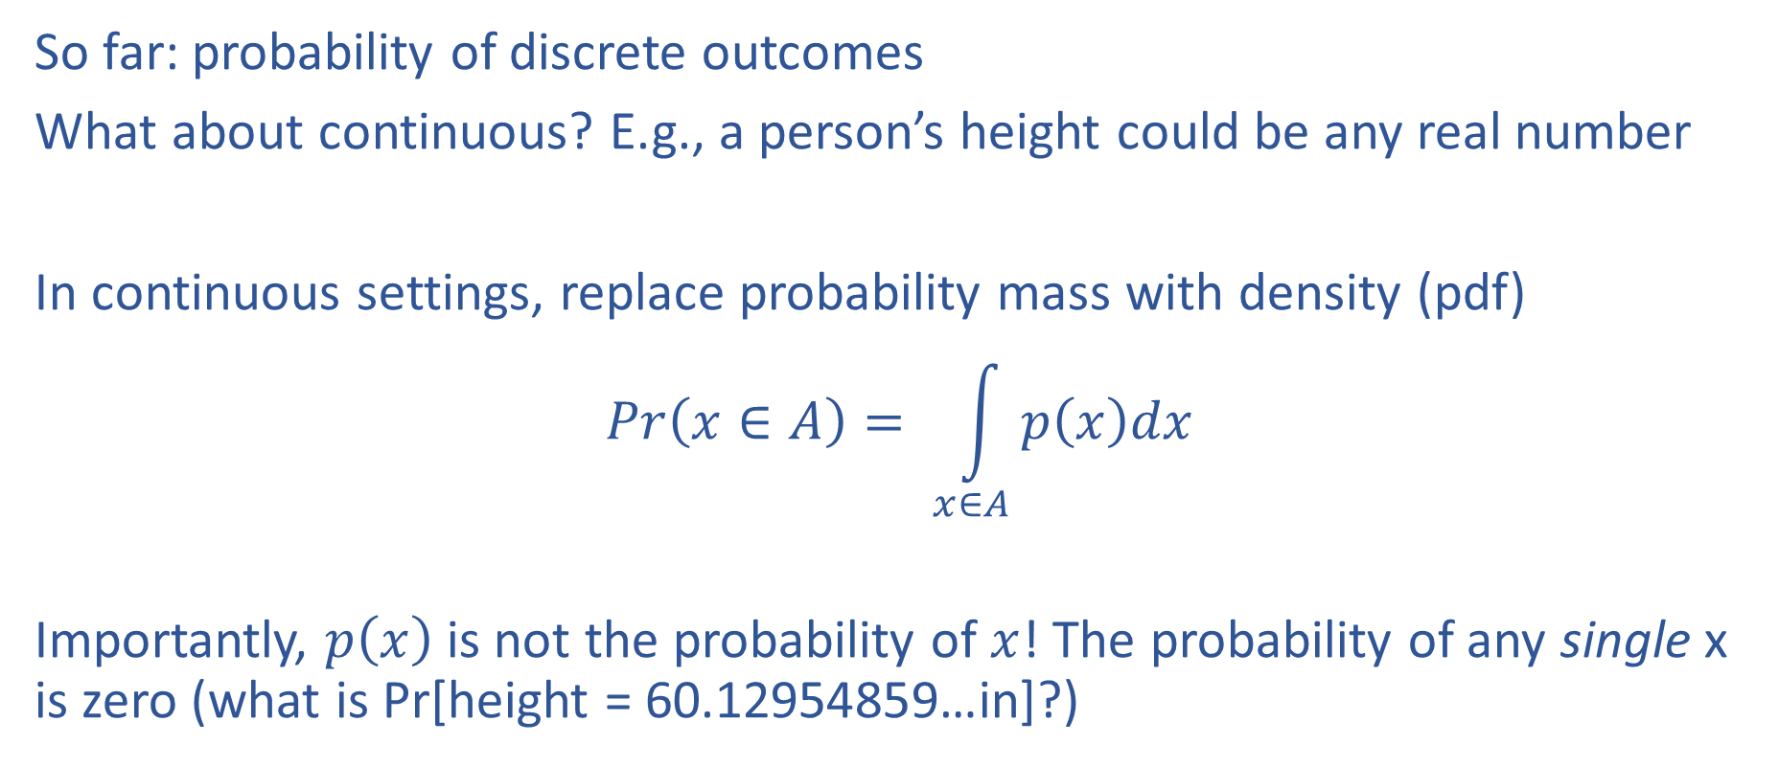
Continuous distributions
So far: probability of discrete outcomes
What about continuous? E.g., a person’s height could be any real number
In continuous settings, replace probability mass with density (pdf)
$$Pr\left(x∈A\right)= \int_{x∈A}{p\left(x\right)dx}$$
Importantly, $p\left(x\right)$ is not the probability of $x$! The probability of any single x is zero (what is Pr[height = 60.12954859…in]?)

Slide 18
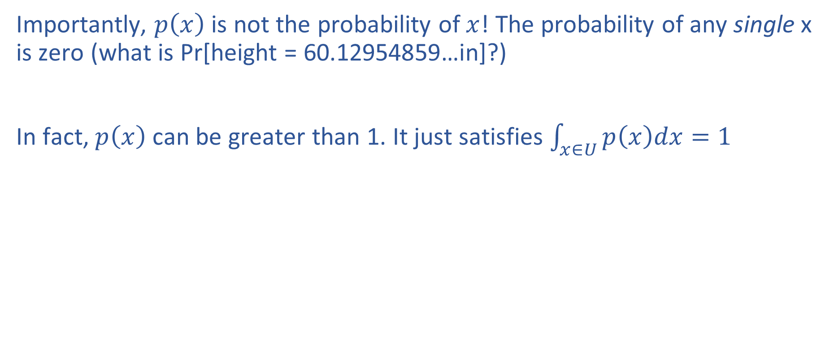
Continuous distributions
Importantly, $p\left(x\right)$ is not the probability of $x$! The probability of any single x is zero (what is Pr[height = 60.12954859…in]?)
In fact, $p\left(x\right)$ can be greater than 1. It just satisfies $\int_{x∈U}{p\left(x\right)dx=1}$

Slide 19
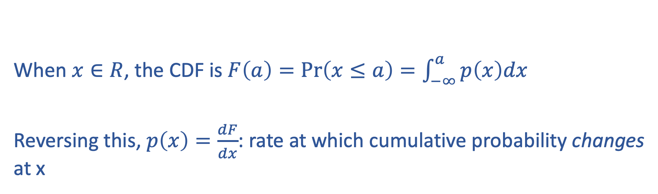
Cumulative distribution functions
When $x∈R$, the CDF is $F\left(a\right)=\operatorname{Pr}\left(x≤a\right)=\int_{−∞}^{a}{p\left(x\right)dx}$
Reversing this, $p\left(x\right)=\frac{dF}{dx}$: rate at which cumulative probability changes at x

Slide 20
Parametric distributions
Common families of distributions which set a functional form for the mass or density function
Go-to tools for writing down models, doing analysis, etc

Slide 21
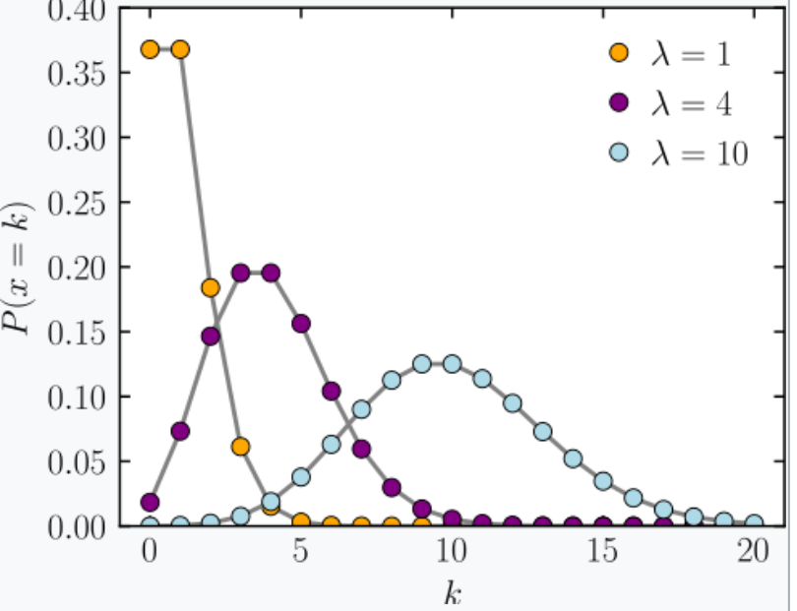
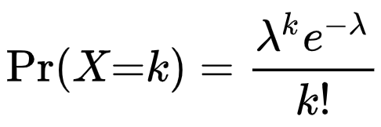
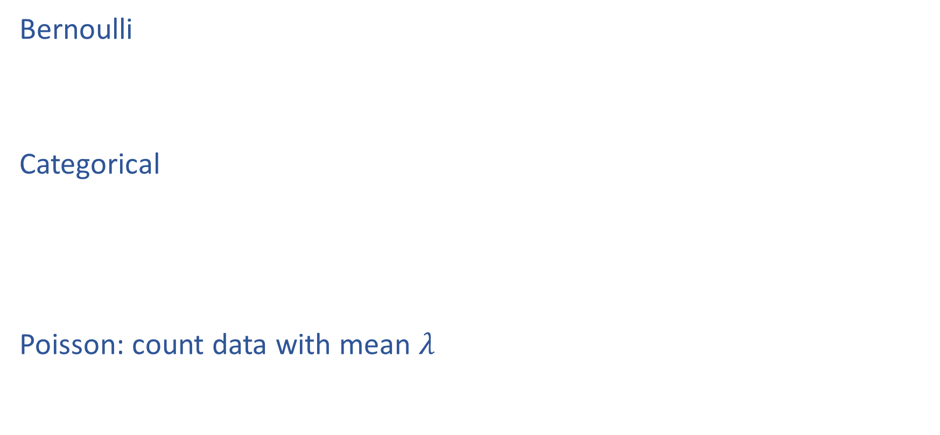
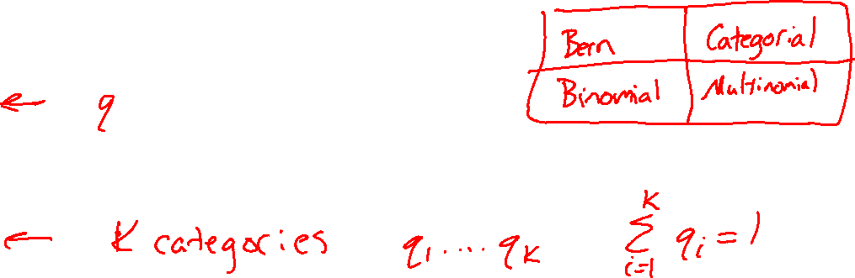
Example Discrete Distributions
Bernoulli
Categorical
Poisson: count data with mean $λ$
https://en.wikipedia.org/wiki/Poisson_distribution

Slide 22
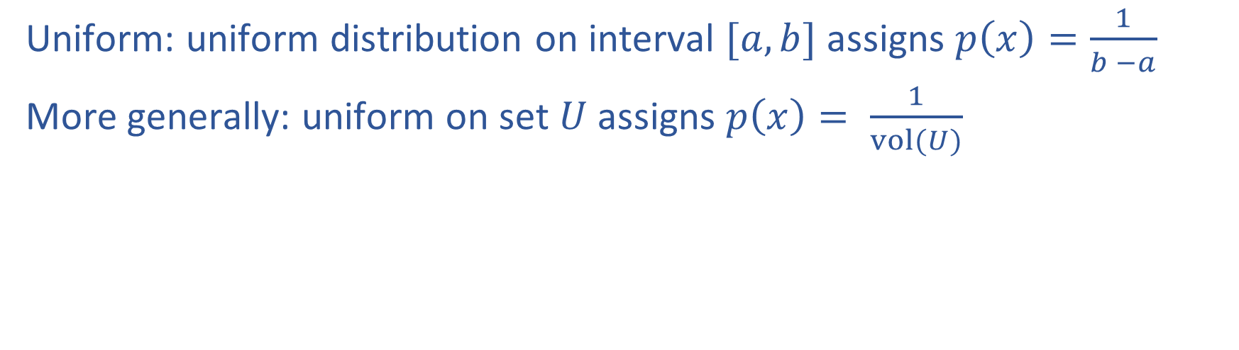
Continuous distributions
Uniform: uniform distribution on interval $[a,b]$ assigns $p\left(x\right)=\frac{1}{b −a}$
More generally: uniform on set $U$ assigns $p\left(x\right)= \frac{1}{vol(U)}$

Slide 23
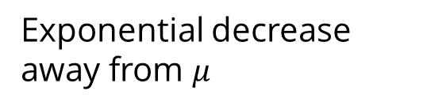
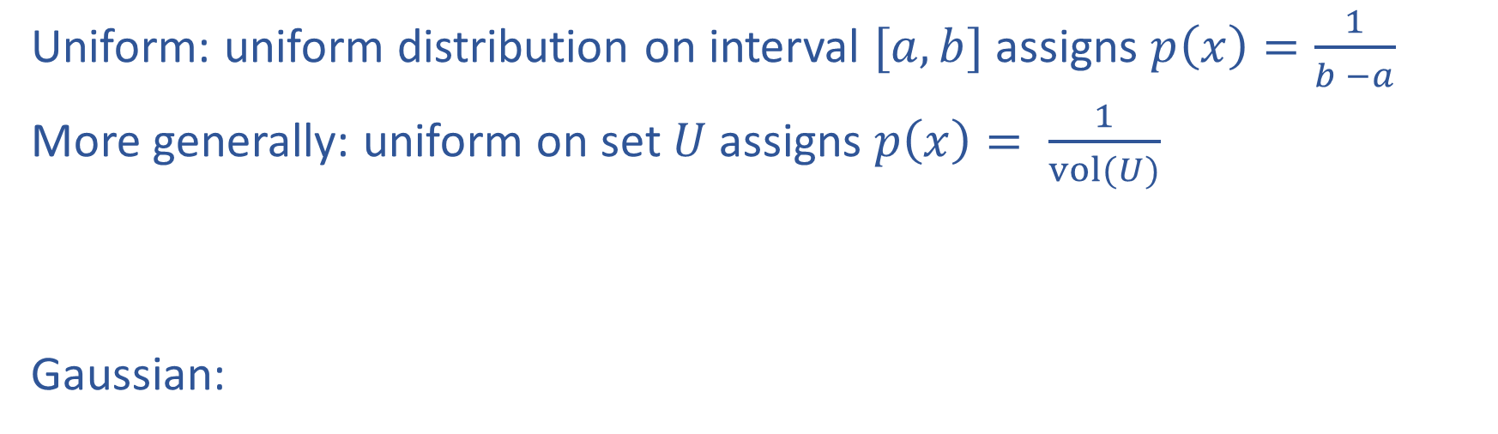
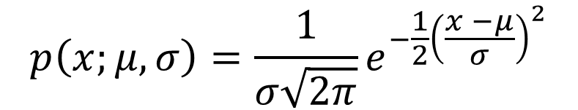
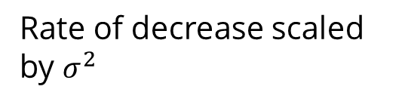
Continuous distributions
Uniform: uniform distribution on interval $[a,b]$ assigns $p\left(x\right)=\frac{1}{b −a}$
More generally: uniform on set $U$ assigns $p\left(x\right)= \frac{1}{vol(U)}$
Gaussian:
Exponential decrease away from $μ$
$$p\left(x;μ, σ\right)=\frac{1}{σ\sqrt{2π}}e^{−\frac{1}{2}{\left(\frac{x −μ}{σ}\right)}^{2}}$$
Rate of decrease scaled by $σ^{2}$
mean
Standard deviation

Slide 24
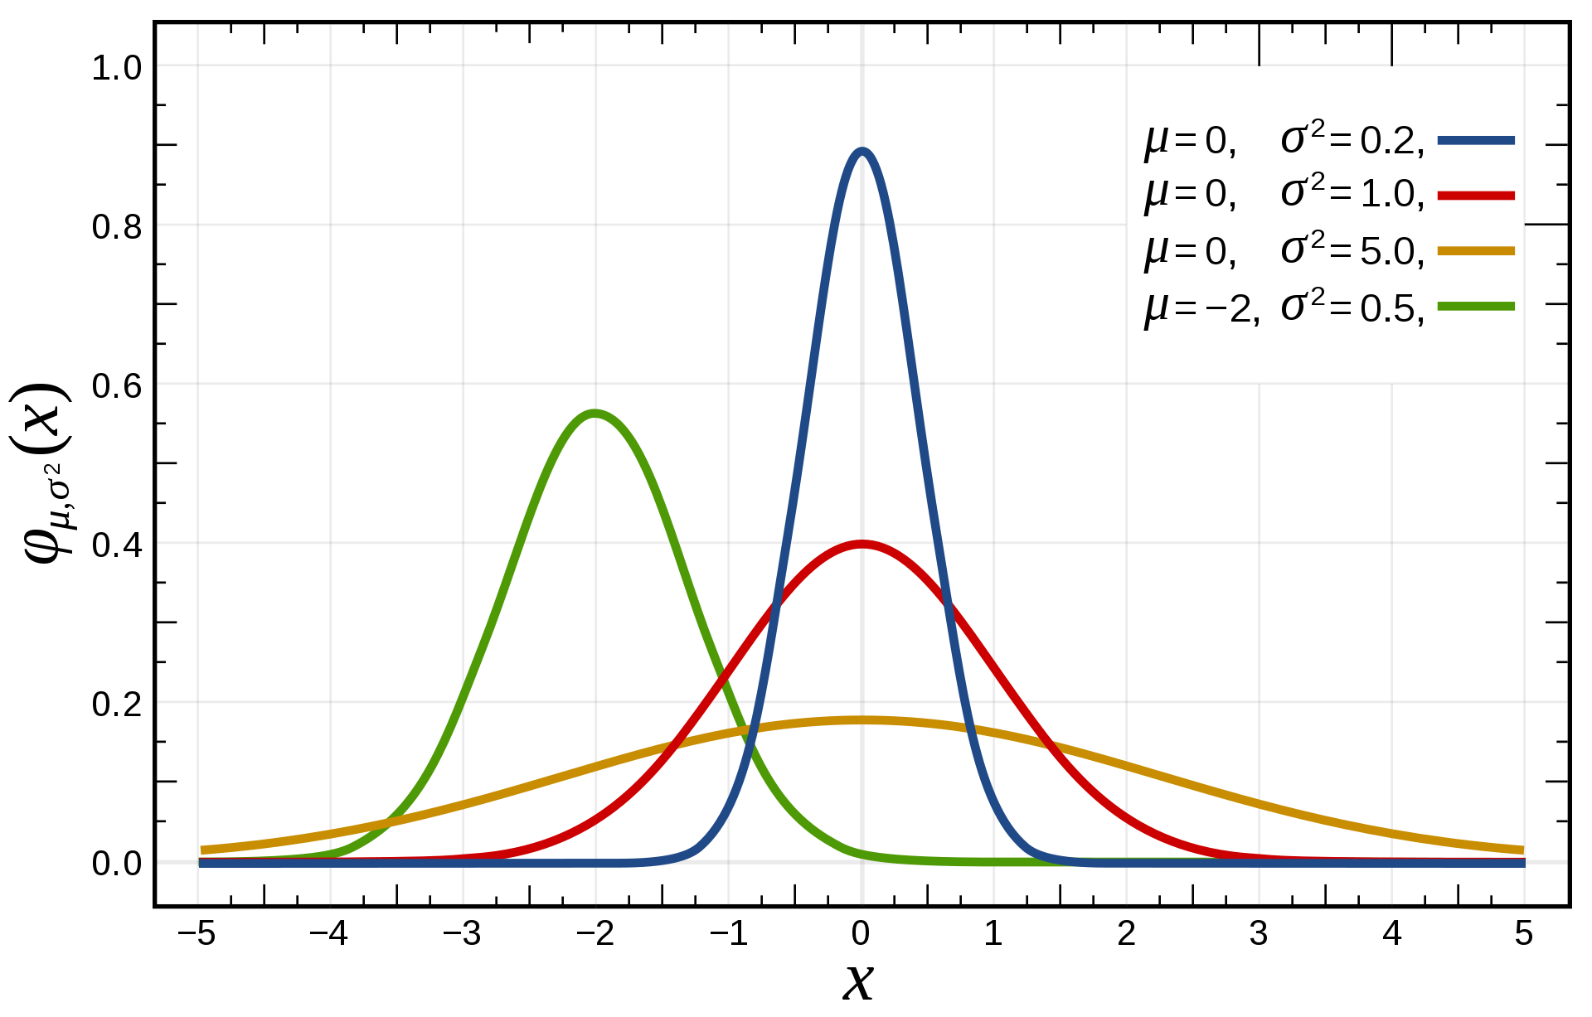
$$p\left(x;μ, σ\right)$$

Slide 25
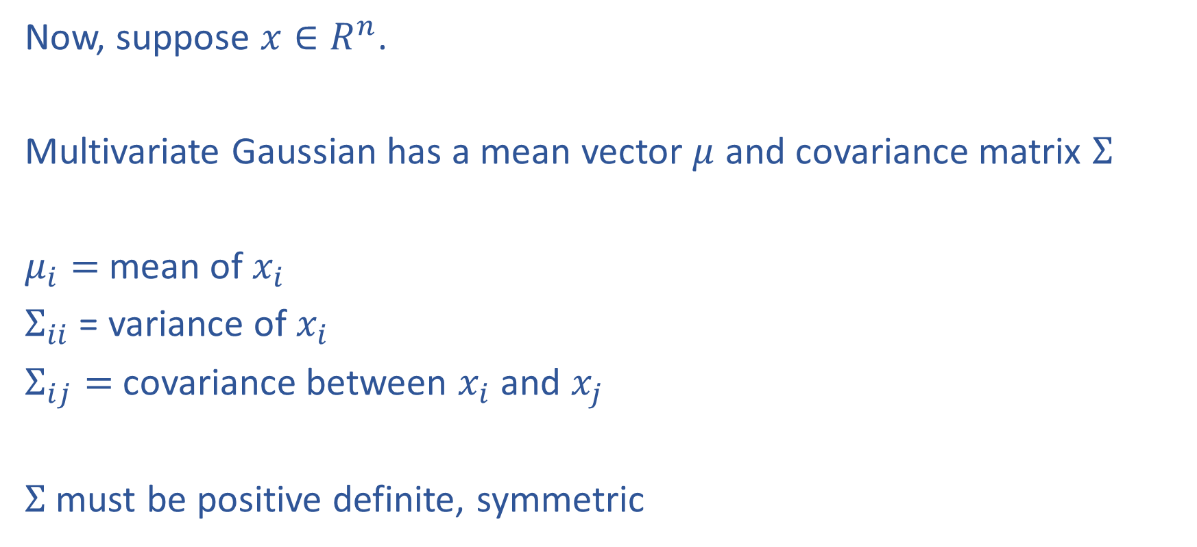
Multivariate Gaussian
Now, suppose $x∈R^{n}$.
Multivariate Gaussian has a mean vector $μ$ and covariance matrix $Σ$
$μ_{i}=$mean of $x_{i}$
$Σ_{ii}$ = variance of $x_{i}$
$Σ_{ij}=$covariance between $x_{i}$ and $x_{j}$
$Σ$ must be positive definite, symmetric

Slide 26
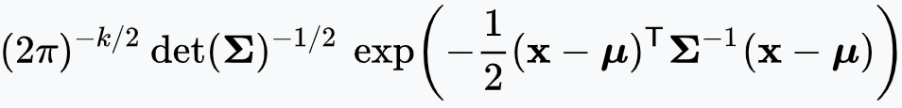
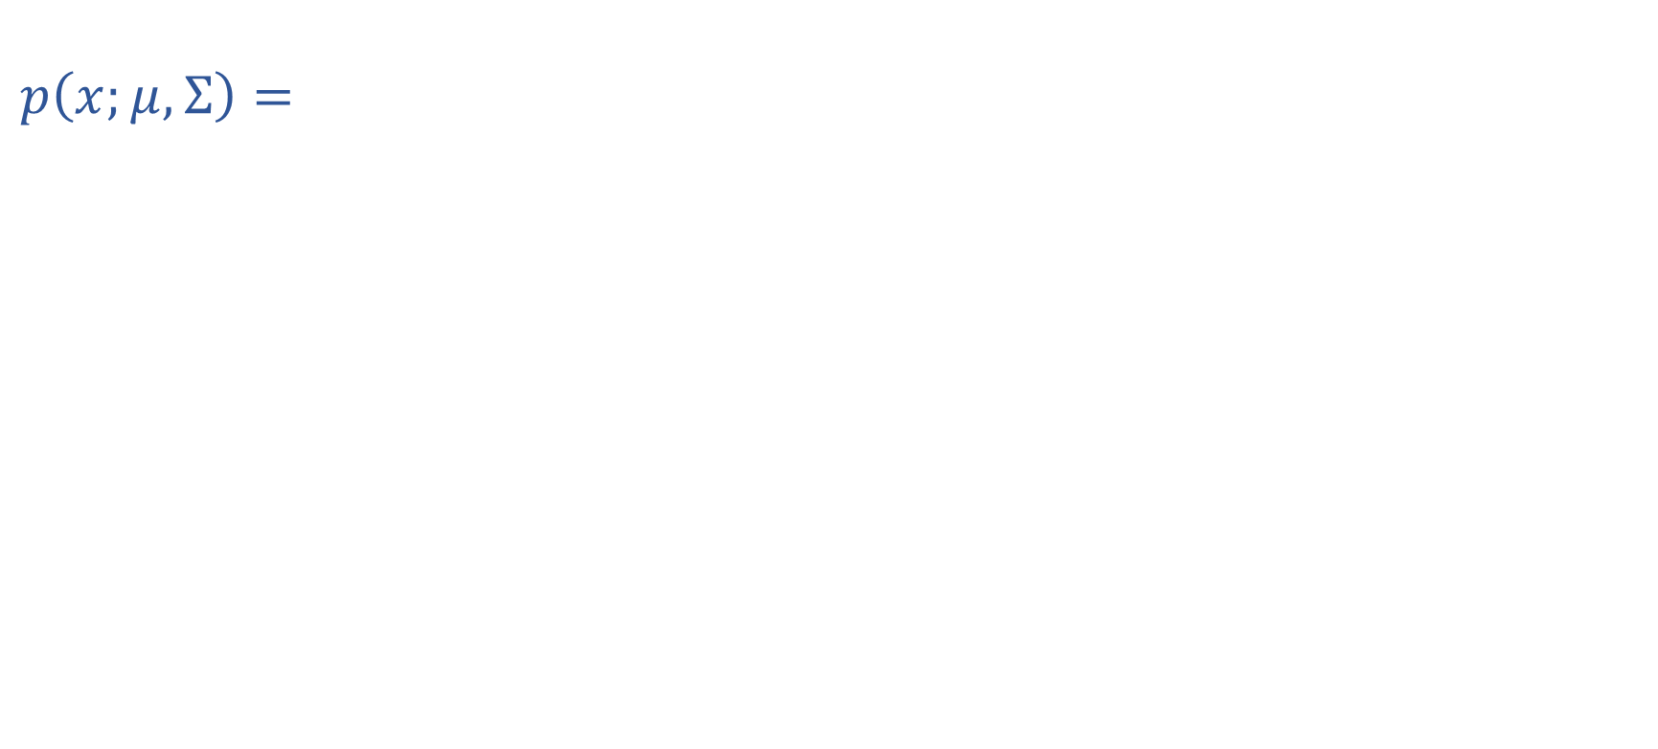
Multivariate Gaussian
$$p\left(x;μ, Σ\right)=$$
Distance from $x$ to $μ$ under norm induced by $Σ^{−1}$

Slide 27
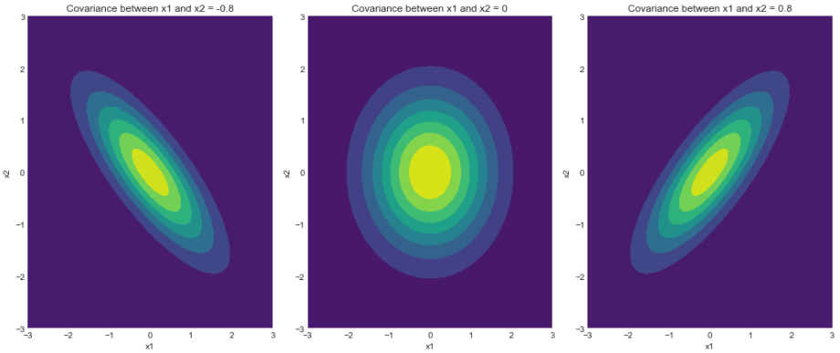
Multivariate Gaussian
https://www.geeksforgeeks.org/visualizing-the-bivariate-gaussian-distribution-in-python/

Slide 28
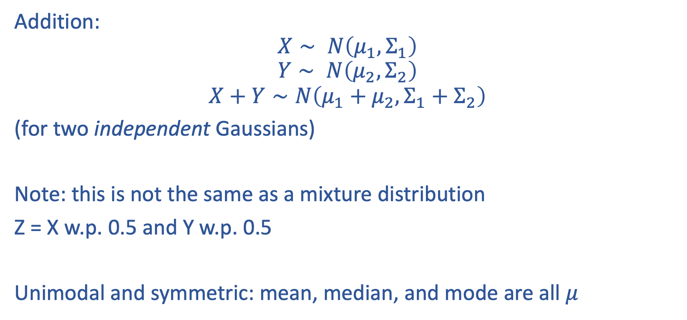
Properties of Gaussians
Addition:
$$X∼ N\left(μ_{1}, Σ_{1}\right)$$
$$Y∼ N\left(μ_{2}, Σ_{2}\right)$$
$$X+Y∼N\left(μ_{1}+μ_{2}, Σ_{1}+Σ_{2}\right)$$
(for two independent Gaussians)
Note: this is not the same as a mixture distribution
Z = X w.p. 0.5 and Y w.p. 0.5
Unimodal and symmetric: mean, median, and mode are all $μ$

Slide 29
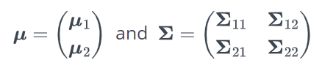
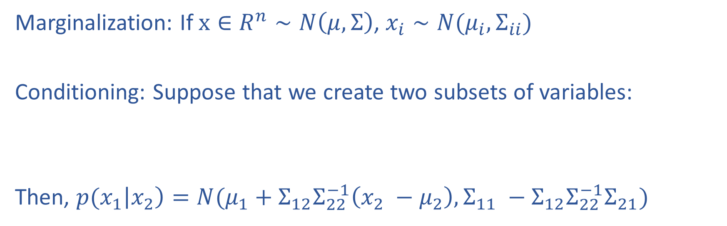
Properties of Gaussians
Marginalization: If $x∈R^{n}∼N\left(μ, Σ\right)$, $x_{i}∼N(μ_{i}, Σ_{ii})$
Conditioning: Suppose that we create two subsets of variables:
Then, ${p(x}_{1}\left|x_{2}\right)=N(μ_{1}+Σ_{12}Σ_{22}^{−1}\left(x_{2} −μ_{2}\right), Σ_{11} −Σ_{12}Σ_{22}^{−1}Σ_{21})$

Slide 30
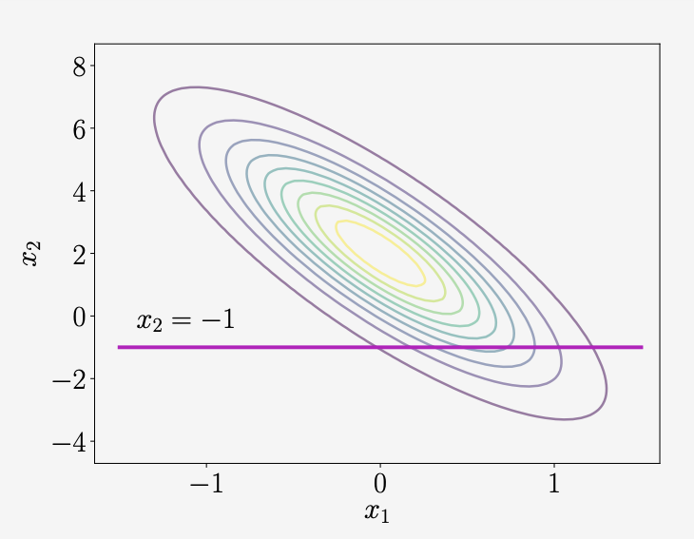
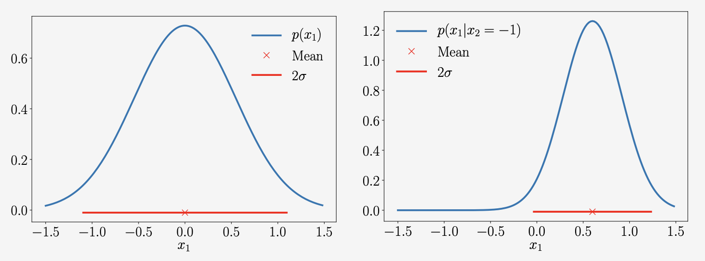
Example
Marginal
Conditional

Slide 31
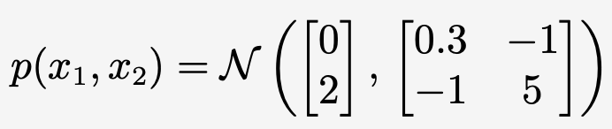
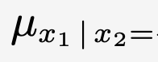
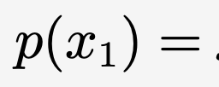
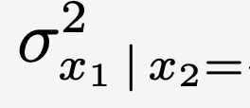
Example

